Slide 1
Characteristic of our country

Slide 2
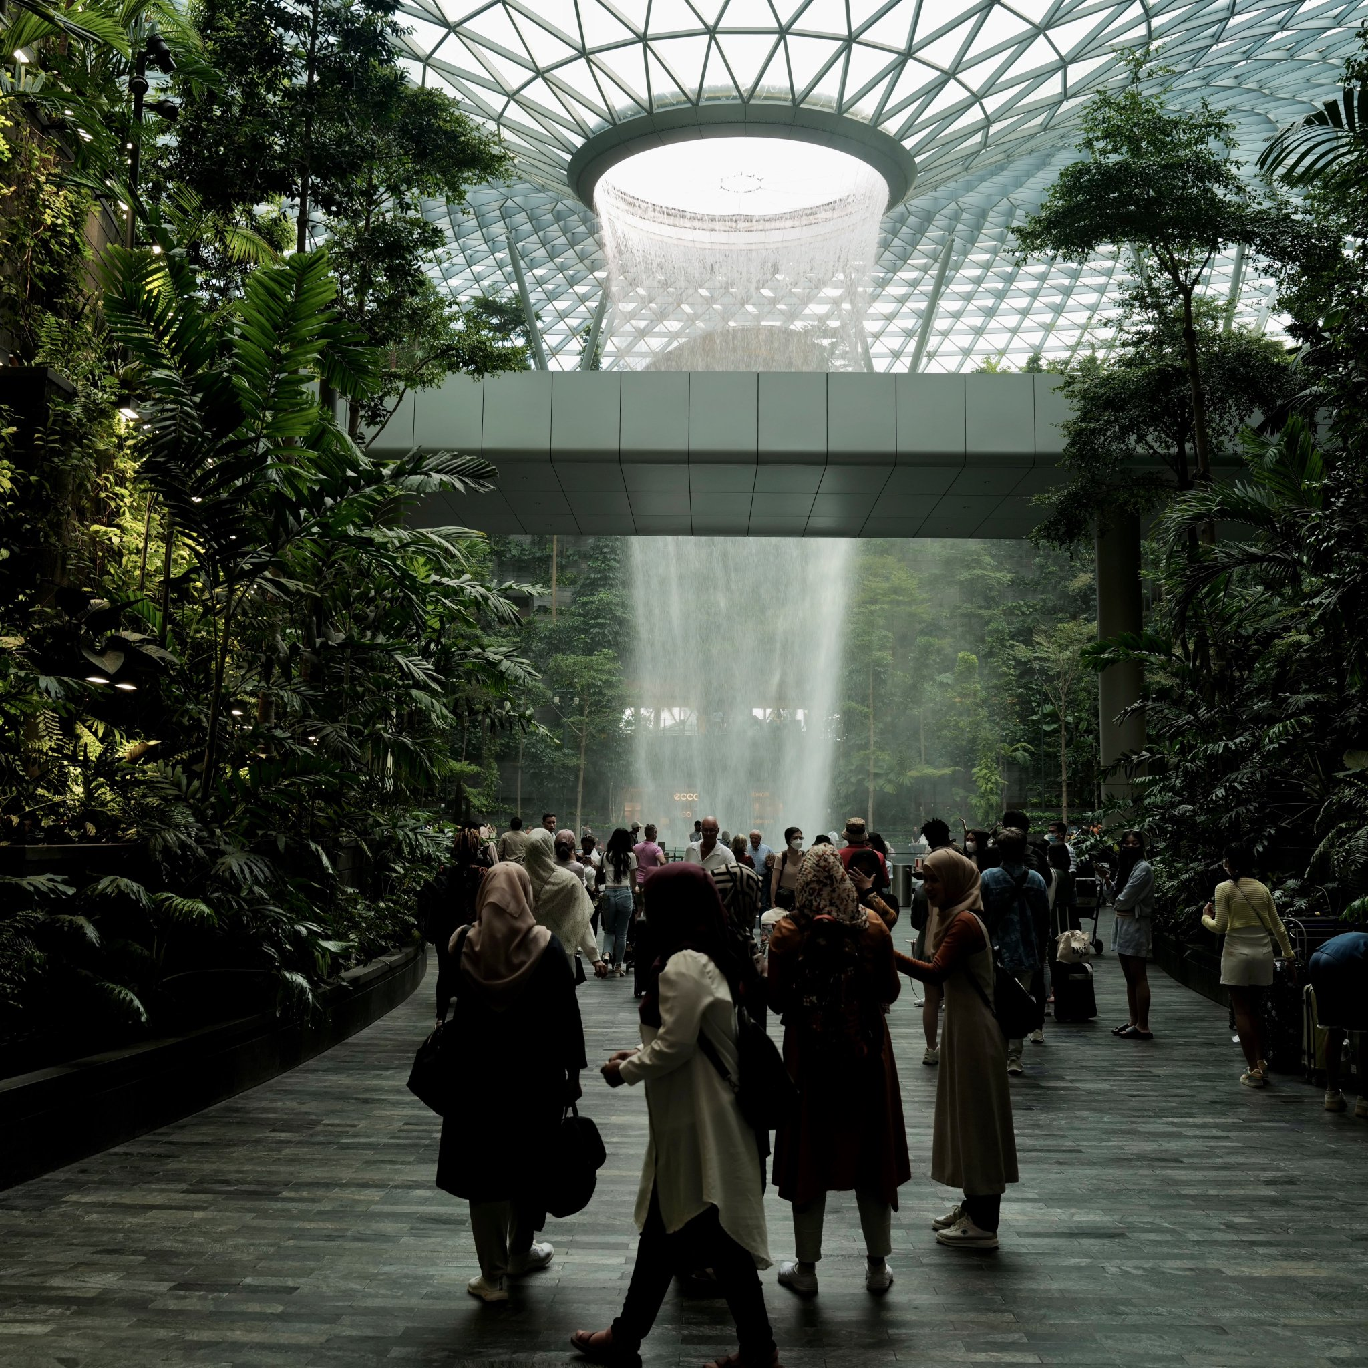
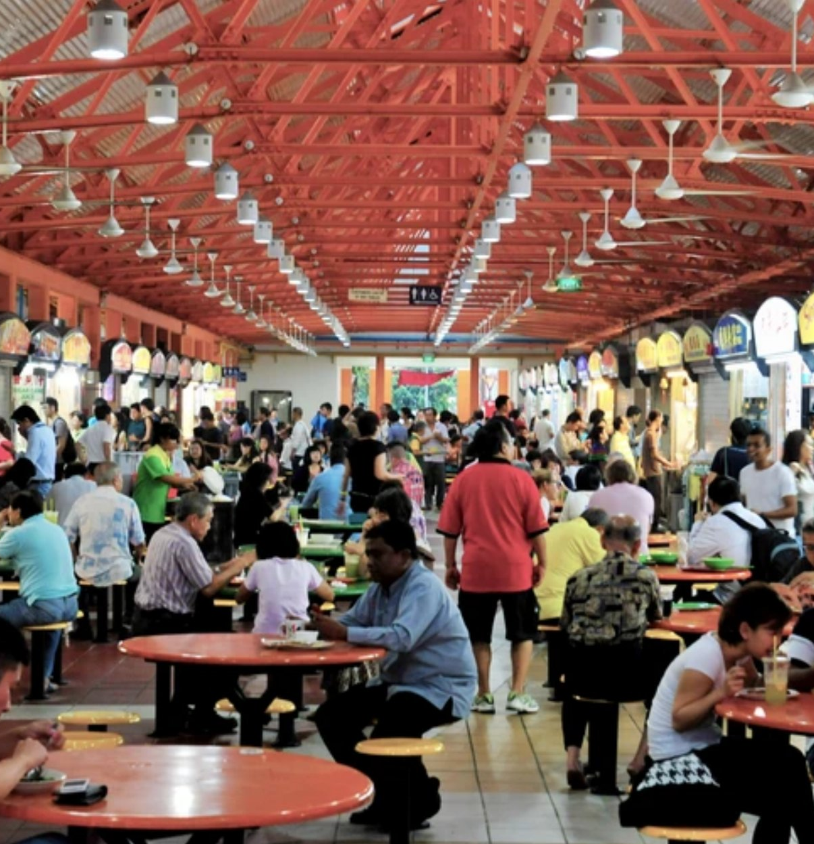
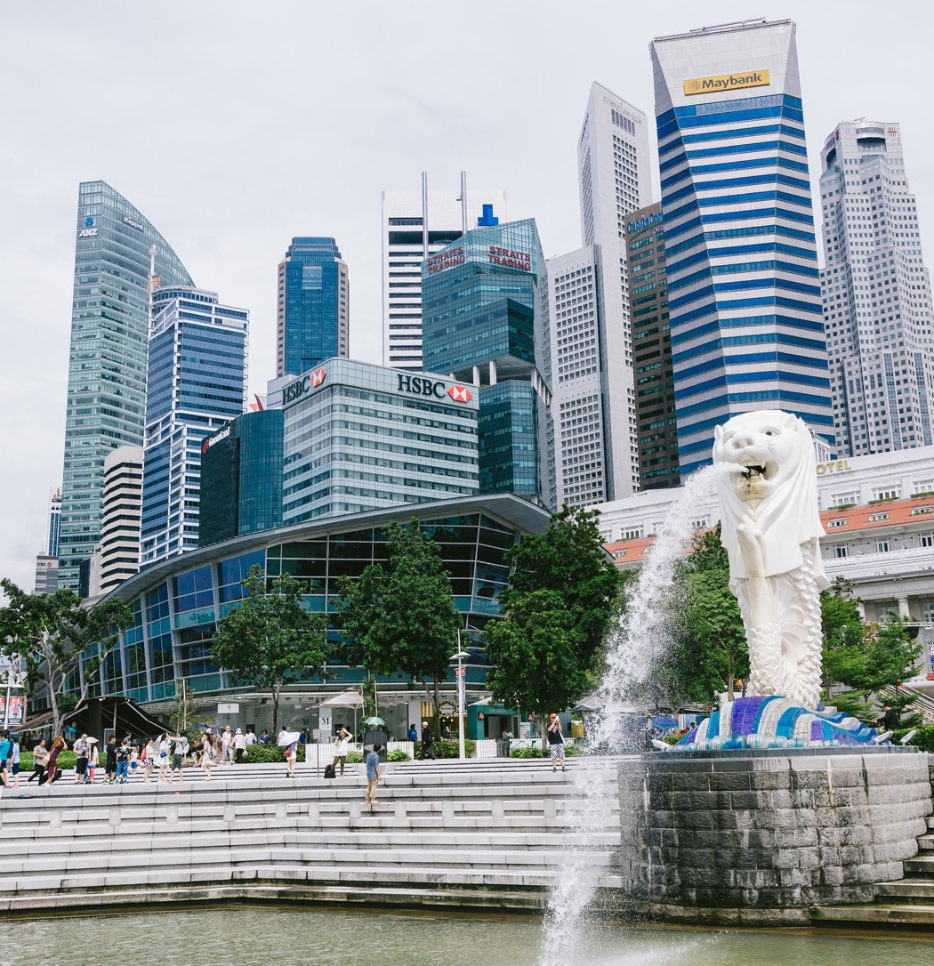
Quiz
Where is that ?

Slide 3
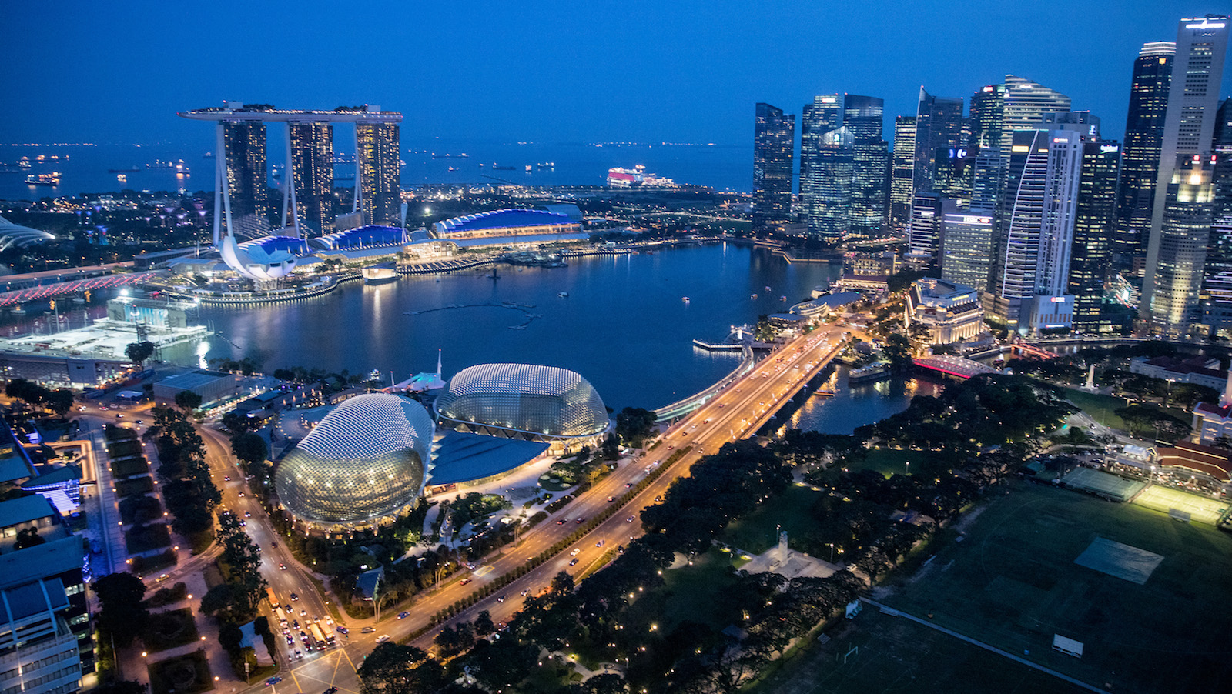
SINGAPORE

Slide 4
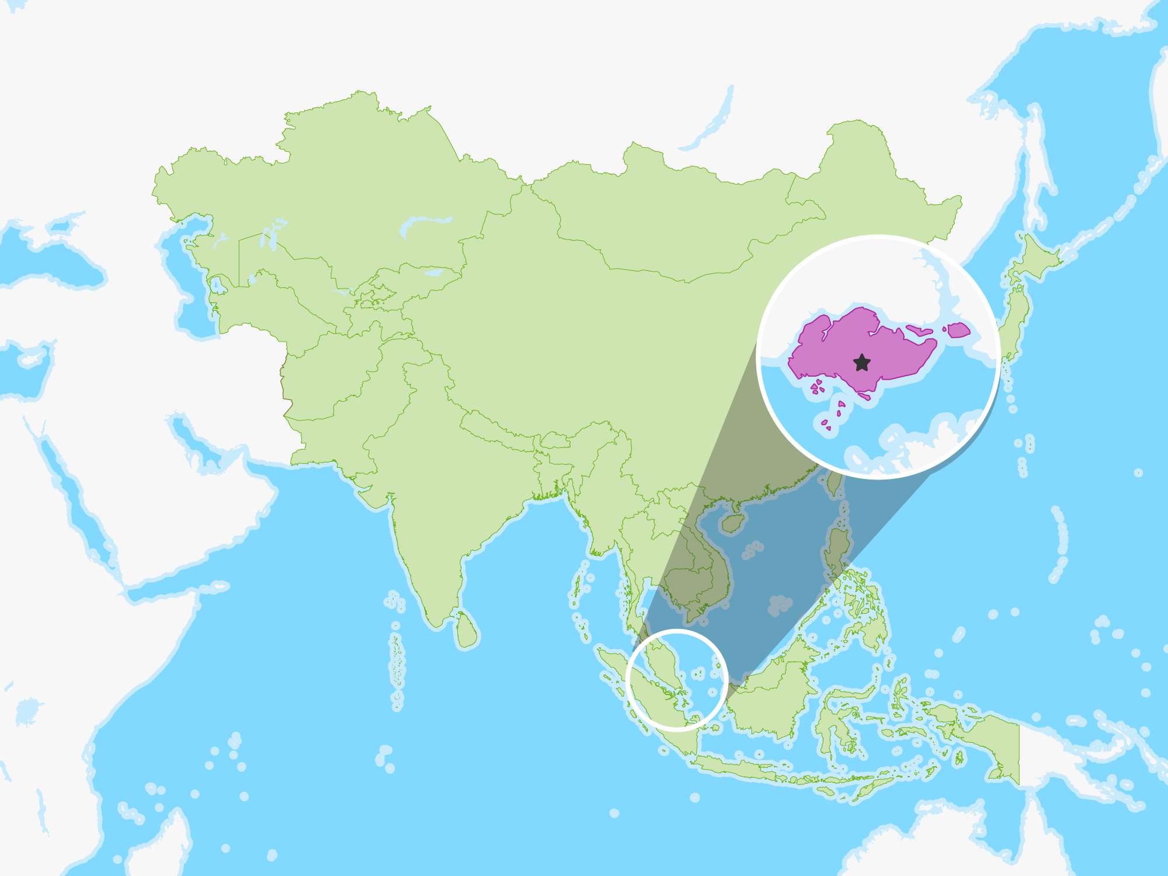
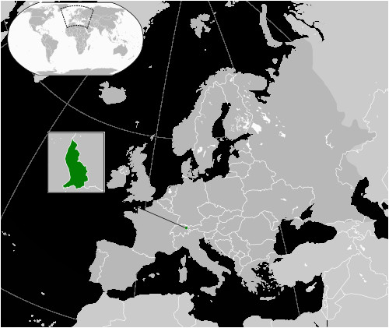
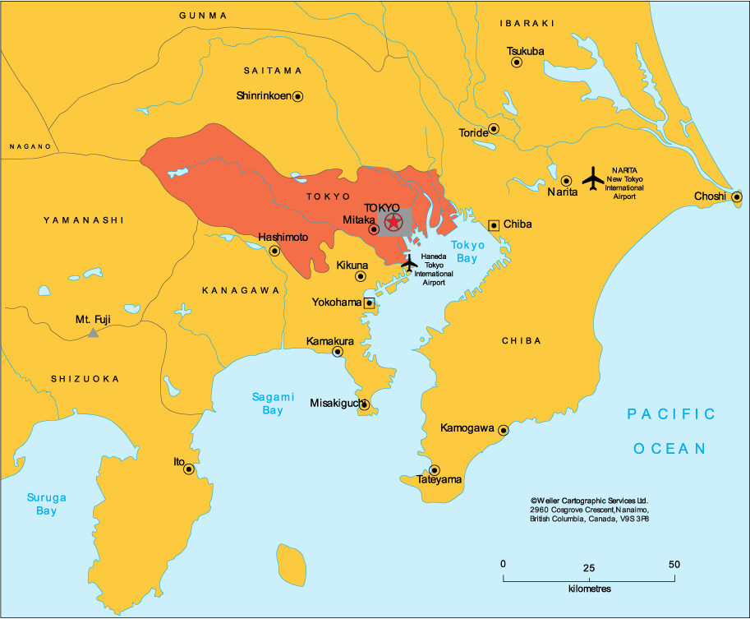
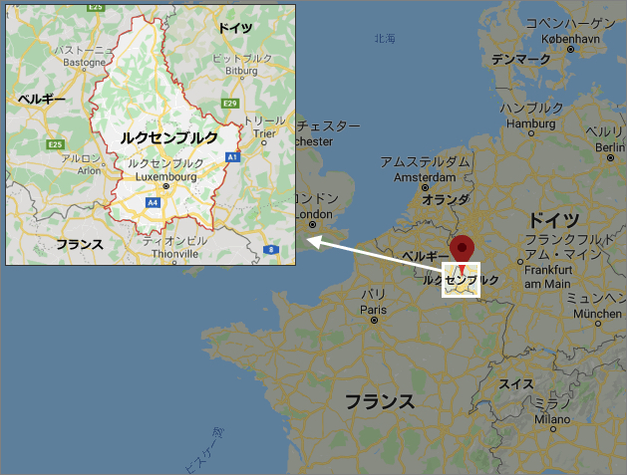
Which size is the most similar?
Singapore
Tokyo
Luxembourg
Liechtenstein

Slide 5
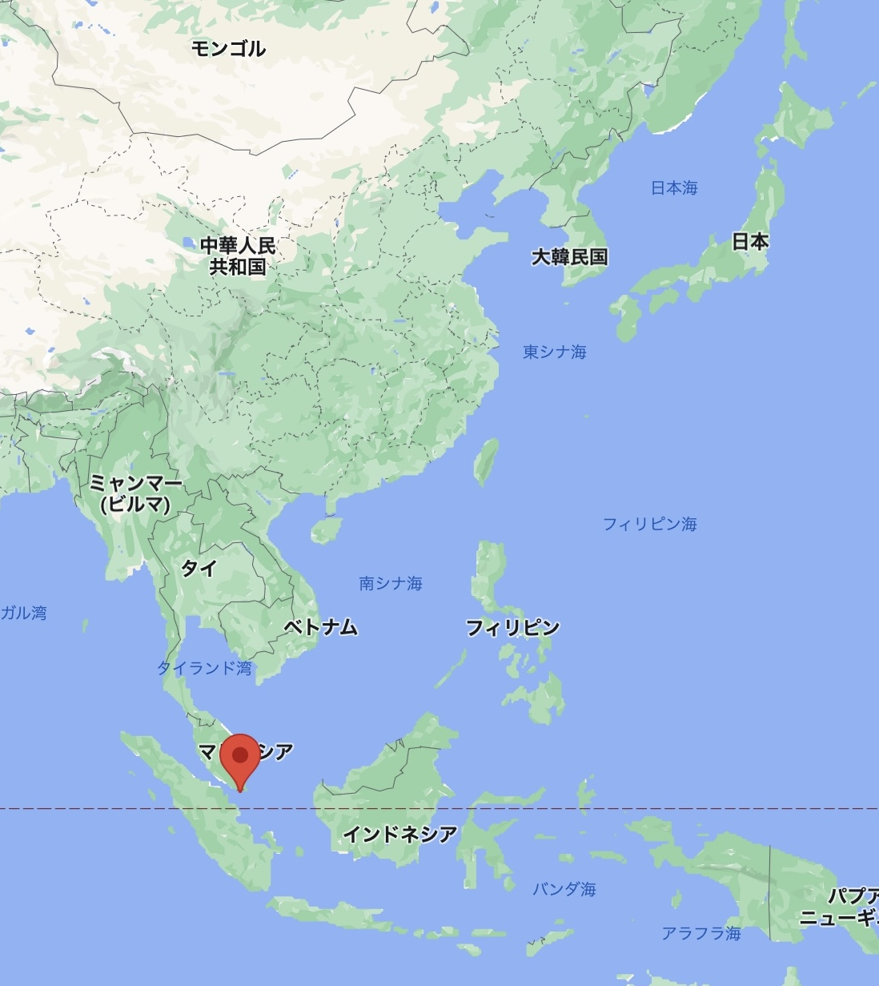
A. TOKYO
Liechtenstein : 160 ㎢ （189th)
Luxembourg : 2,586 ㎢ (167th)
Tokyo 23 city : 627 ㎢
Singapore : 721 ㎢ (175th)
Singapore consists of 63 islands.
Singapore is expanding the land by reclamation of the sea.

Slide 6
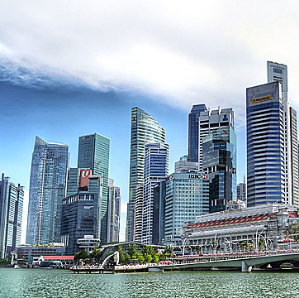
Information
Business country
Easy access to Southeast Asia.
English.
Low corporate tax.
→so there are many races.

Slide 7
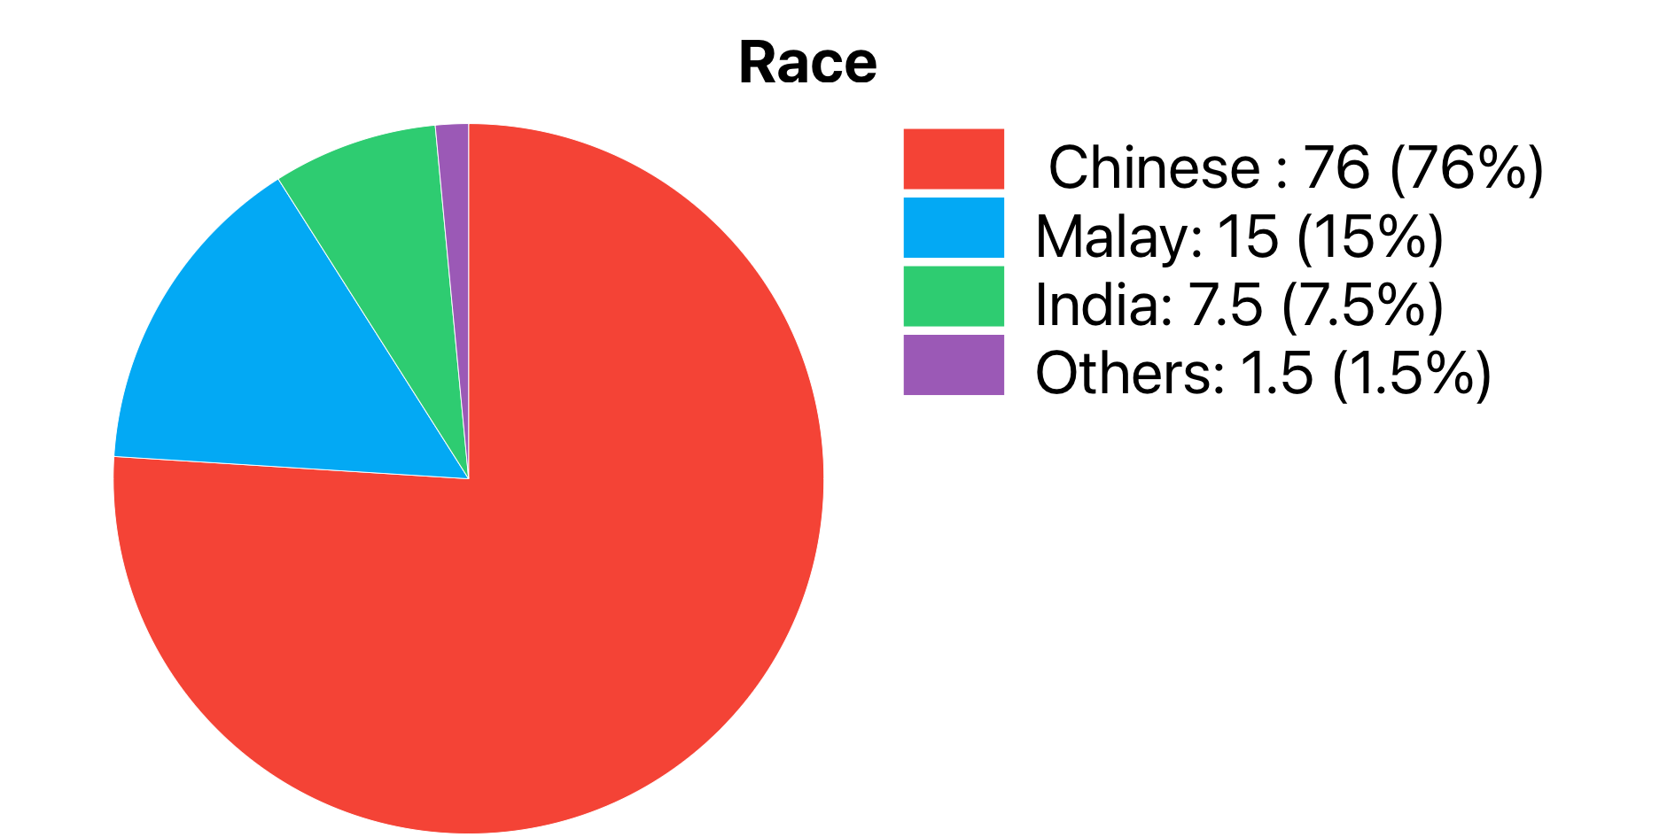
Infomation
Population: 5,690,000.
(Singaporeans is 4,040,000)
Many races coexist. ＝Multiethnic
Language :
①English, ②Chinese
③Malay and ④Tamil.
British Colony in 1824.
Chinese Immigrants
Singapore’s national language.
Indian Immigrants

Slide 8
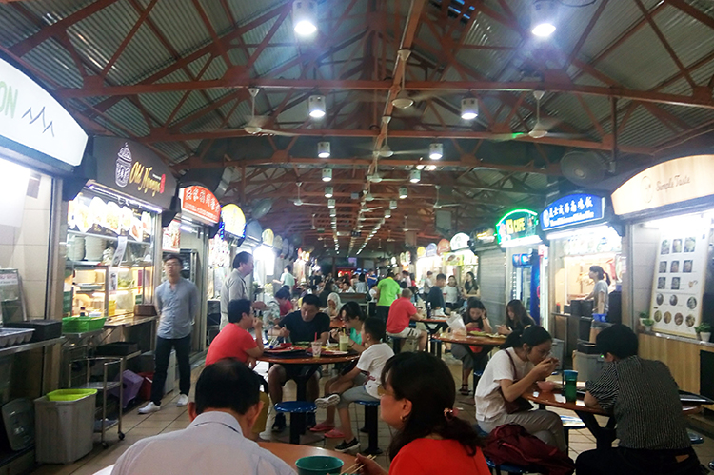
Foods
Multiethnic food
Food court and Hawkers

Slide 9
Low avoidance 8
There are many rules and fine.
There are cleaner.
They tend to follow rules.

Slide 10
Collectivist 20
They have priority communication moral over task fulfillment.
They prefer group to individual.

Slide 11
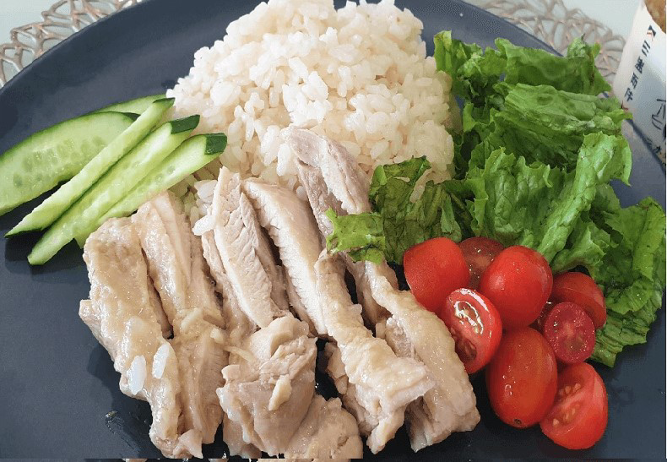
How much for chicken rice at food court?
About 3~5 dollars
About 5~7 dollars
About 7~10 dollars

Slide 12
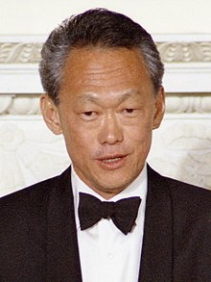
Work
Lee Kuan Yew
A Source of social suitability and economic development
have worked hard and improved themselves should be treated and valued fairly, regardless of their ethnicity, language, or religion.

Slide 13
Work
Live in competitive society
Evacuated by a boss

Slide 14
Work
Communicate so directly because Common knowledge is different in the diverse society.
Prefer to divide the task
On time when going back home

Slide 15

Work
Don’ t move by themselves.
Don’t mean that being afraid of failing
These are coming from that if their way to do is different with bosses, it is wasting time,

Slide 16
Work
If you want to work in Shigapore
Required feedback
Positive feedback is just to praise.
Contract feedback was used when you want the other person to improve. You need to point out the bad part.

Slide 17
Quiz
How much percent of national budget does the government invest for education?
1, 3%
2, 10%
3, 20%
4, 30%

Slide 18
Quiz
How long is the mandatory education?
1, the elementary school
2, the junior high school
3, the high school
4, the university

Slide 19

Quiz
What is the rank of Singapore university in the world university ranking?

Slide 20
Education
The answer is 11th
Tokyo university is 23th
the education basis of Lee Kuan Yew is that putting in a system that can talentedly people from among its own citizens into the government.

Slide 21

Education
Education is very high and competitive

Slide 22
Education
What is PLSE
A primary school leaving examination
Subject:
English(Listening, speaking, paper test), second Language, Mathematics, Science

Slide 23

Education
PLSE
66.3% express - Junior high school 4-year course
21.2% normal academic - Middle school 5-year course
11.0% normal technical Middle school - 5-year technical course
1.6% failure - take again until pass

Slide 24

Education
If get a good score, you can go to a class for university
If not get, go to the job training
- it’s difficult to go to university
The life is decided by this test at the age of 12.

Slide 25
Conclusion
Food
Regulation
The characteristic of work
Education

Slide 26
Conclusion
Why Singapore grow up so quickly
Not have natural sources like water, mining, national land and cultivated land.
The only way to survive in the global society is to grow up the people.

Slide 27
That is all the characteristic of our country.

Slide 28
Thank you for listening

